Slide 1
Road and field boundary detection in satellite imagery
Group 15
Harshavardhan Reddy Mallanagari
Preethi Vahitha Sankineni
Sasidhar Yalamanchili

Slide 2
Topics
Dataset
​Preprocessing
Methodology
Sample Code
Preliminary Results
​Timeline – Future work

Slide 3
Dataset-Ground truth
- Manually annotated the image for ground truth.
- Helps in finding accuracy of the model.
Source : apeer.com

Slide 4
Preprocessing
- Applying preprocessing techniques like
1. Gaussian Filter
2. Median Filter
3. Histogram Equalization
4. Histogram Stretching

Slide 5
Methodology
- The methods applied on the dataset are
1. Sobel edge Detection
2. Canny edge Detection
3. Harris Corner Detection
- The methods specified above are applied with different thresholds along with inputs which were processed earlier in the preprocessing phase.
- Finding the best threshold that fits the model.

Slide 6
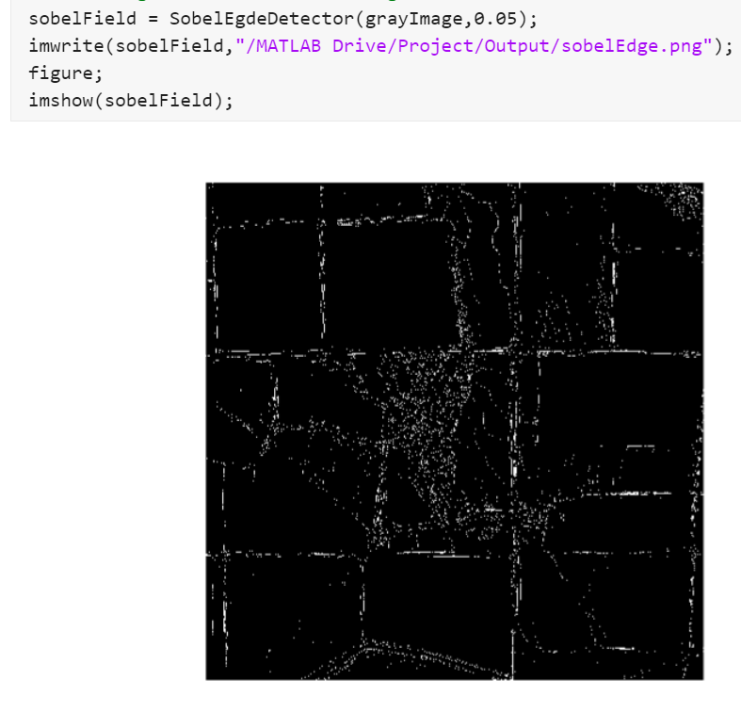
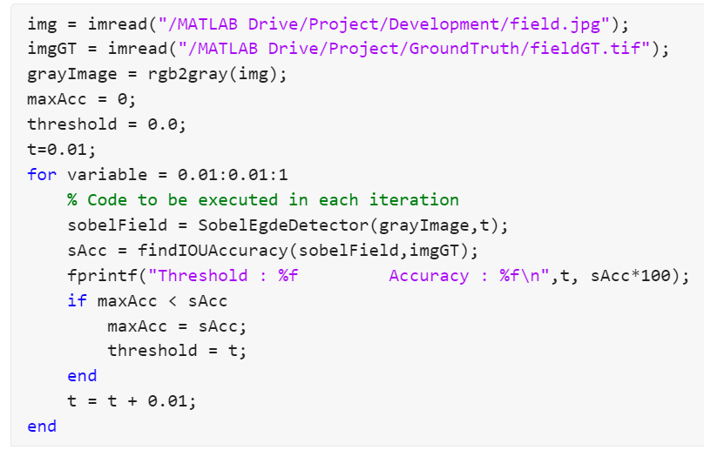
Sample Code

Slide 7
Preliminary results
Model Name | Filter | Threshold | Accuracy
Sobel Edge Detection | None | Default | 7.875558
Sobel Edge Detection | Gaussian | 0.05 | 7.849831
Sobel Edge Detection | Median | Default | 8.102000
Sobel Edge Detection | Histogram equalization | Default | 6.428086
Canny Edge Detection | None | Default | 4.363802
Canny Edge Detection | Gaussian | 0.15 – 0.24 | 8.080580
Canny Edge Detection | Median | Default | 3.991448
Canny Edge Detection | Histogram equalization | Default | 3.260465

Slide 8
Timeline-future work
- Improvise the Ground Truth images.
- Applying filters such as
1. Gabor Filter
2. DoG Filter
3. Unsharp Mask Filter
- Applying Methodologies like
1. Line detection algorithms
2. Hough transform
- Improve the performance of the models developed.

Slide 9
Thank You

